Slide 1
BoonDocks LED Controller
Operating description
Screen Layouts

Slide 2

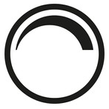
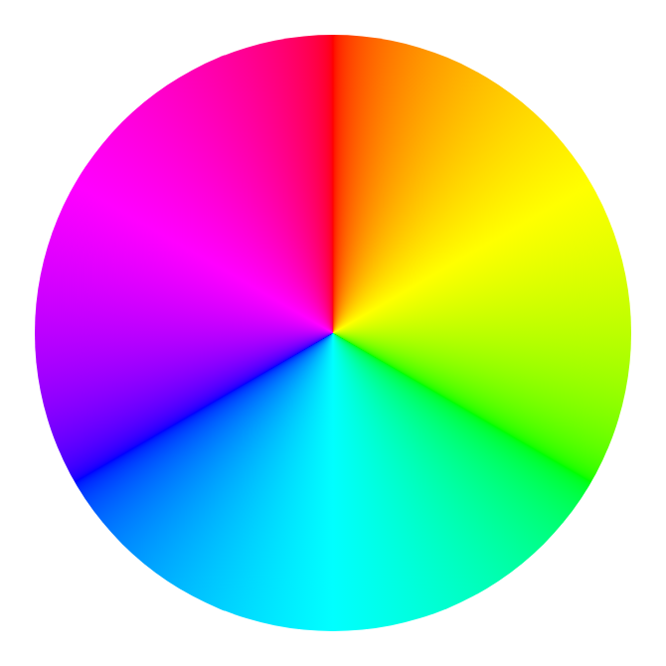
Operating Screens
Icon Operation
Each controller will have its own screen
Bulb “ON” / “OFF” State
Dimmer Touch Cycle
Default “on” 100%
CTL X Name
Username
Username
Haptic response on touch
Click – ringer “ON”
Vibrate – ringer “OFF”
100%
Username
50%
Color wheel operation
Bluetooth to pico RGB
LED values as finger
Moves through wheel
User Name
Username
25%
0%
Screen used for
RGBW or RBG + 1
Screen used for
4 independent
channels
Haptic response on touch
Click – ringer “ON”
Vibrate – ringer “OFF”
Haptic response on releas
Click – ringer “ON”
Vibrate – ringer “OFF”

Slide 3


Application Operating Page Sequences
Scene MGMT
LED Controller 1
LED Controller 2
LED Controller 3
LED Controller 4
RGBW Name
RGB Name
Chan1 Name
RGB Name
Scene
Scene
Chan2 Name
Scene
Chan3 Name
Scene
Chan4 Name
Chan4 Name
BoonDocks
LED Controls
Chan4 Name
Splash Screen
On App Open
Not in screen rotation in operation
Swipe in app left or right to advance to next screen page rotating back from CTL 4 to Scene page on left swipe. Visa-versa, a right swipe will go from the Scene page to the CTL 4 page.

Slide 4
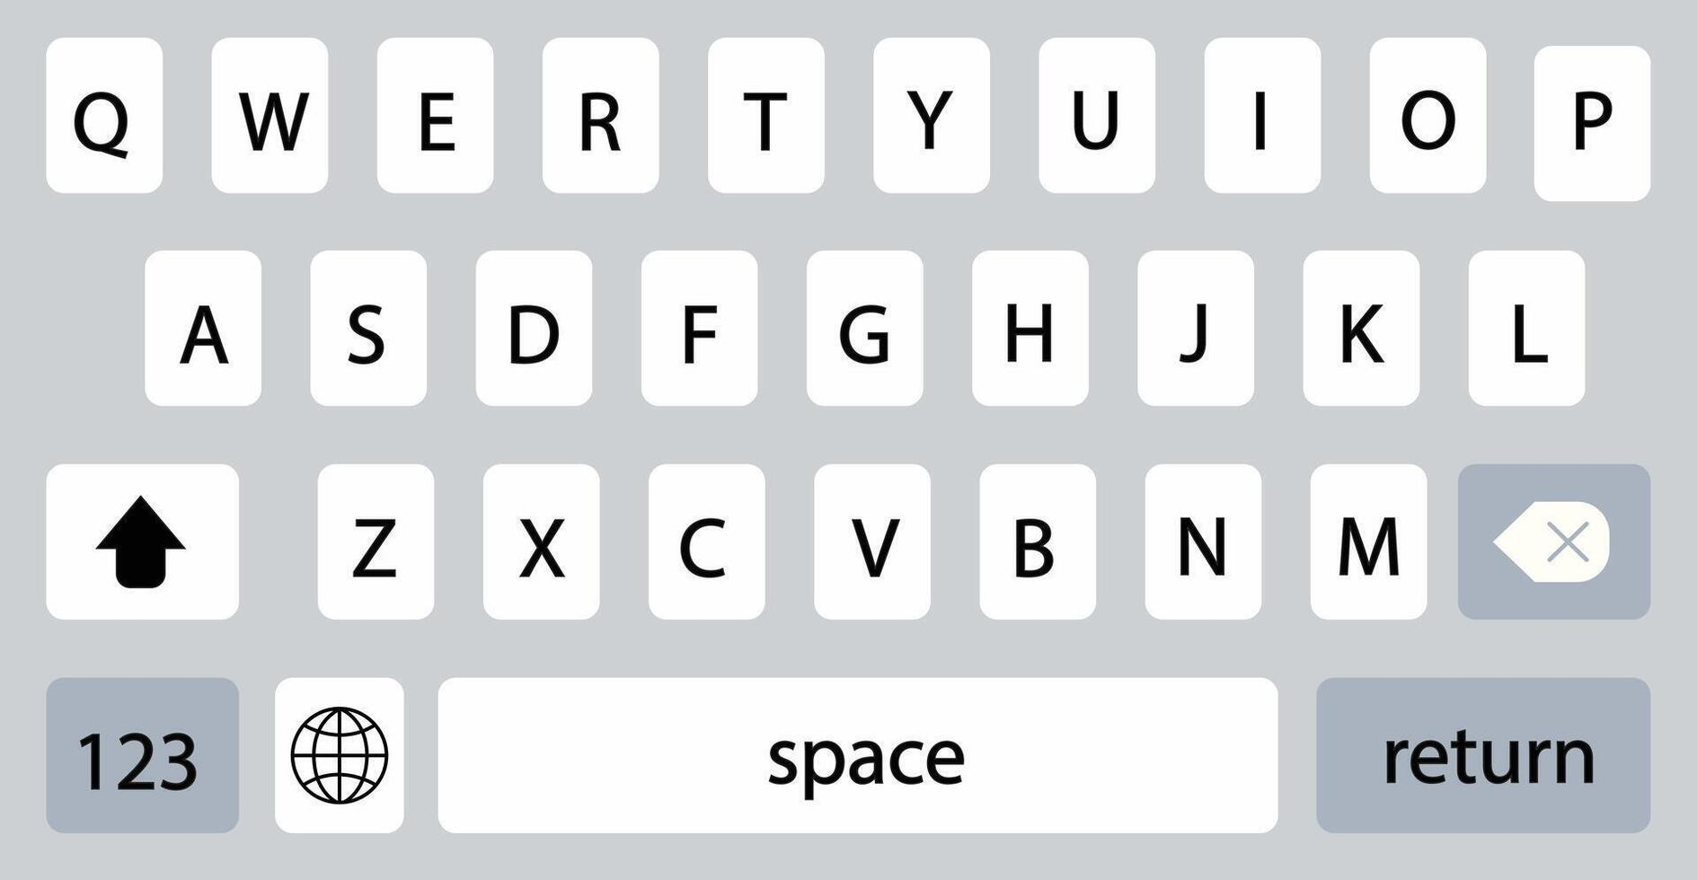
Scene Selection and Screen Saving
Momentary touch < 5 seconds
The scene box turns green to indicate it is selected and will remain selected.
Longer touch > 5 seconds
The scene naming and save screen is presented.
Scene
Scene
Scene
Scene 2
Scene
Scene
Scene
Scene
User Name
Scene
Scene
Scene
Scene
Save Scene
Scene
Scene
Scene
Scene
Scene
Haptic response as scene is touched
Highlight text box green
Click – ringer “ON”
Vibrate – ringer “OFF”
This is a static field for S 1/2/3/4
Scene 1
User name input from keyboard
User Name
Touching this icon takes you to setup page
Save to pico & return to Scene page green highlighted
Save Scene

Slide 5
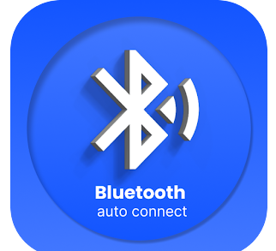
Splash Screen and Bluetooth Conection
App start Splash Screen
Cannot swipe out
Bluetooth connected
Can swipe out to operating screens
Prompt user to connect to system in the native BT environment
System Configuration
*****NOTE******
After BT connection, the APP will upload the system’s JSON stored configuration. This is such that a another/second user to the system will not need to reprogram all the board configs, names, scenes etc.
BoonDocks
LED Controls
BoonDocks
LED Controls
To be determined as needed by Android operating system environment
App starts, established BT connection, waiting tbd seconds for success before prompting user with the native BT connection screen on the phone.

Slide 6


Setup Configuration Screen
Setup splash
Board Config
LED CTL X
LED CTL X RGBW
LED CTL X RGB +1
CH 1 Name
LED CTL 1
CH 2 Name
LED CTL 2
RGBW
Return to Scene page
RGB Name
Username
CH 3 Name
RGB + 1
+1 Name
LED CTL 3
Save CTL X
CH 4 Name
Save CTL X
Save CTL X
LED CTL 4
4 Channel
Return to Setup Splash page
The touch of a box on the Setup Splash takes user to the board config screen. The user selects 1 of 3 configs which then takes the user to the Board naming screen. After the name is saved in the naming page, the system will return to the Setup Splash; and, the text box will be highlighted to show it is setup.

